Slide 1
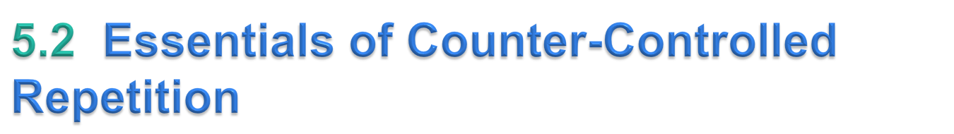
Counter-controlled repetition requires
  a control variable (or loop counter)
  the initial value of the control variable
  the increment by which the control variable is modified each time through the loop (also known as each iteration of the loop)
  the loop-continuation condition that determines if looping should continue.
© Copyright 1992-2015 by Pearson Education, Inc. All Rights Reserved.

Slide 2
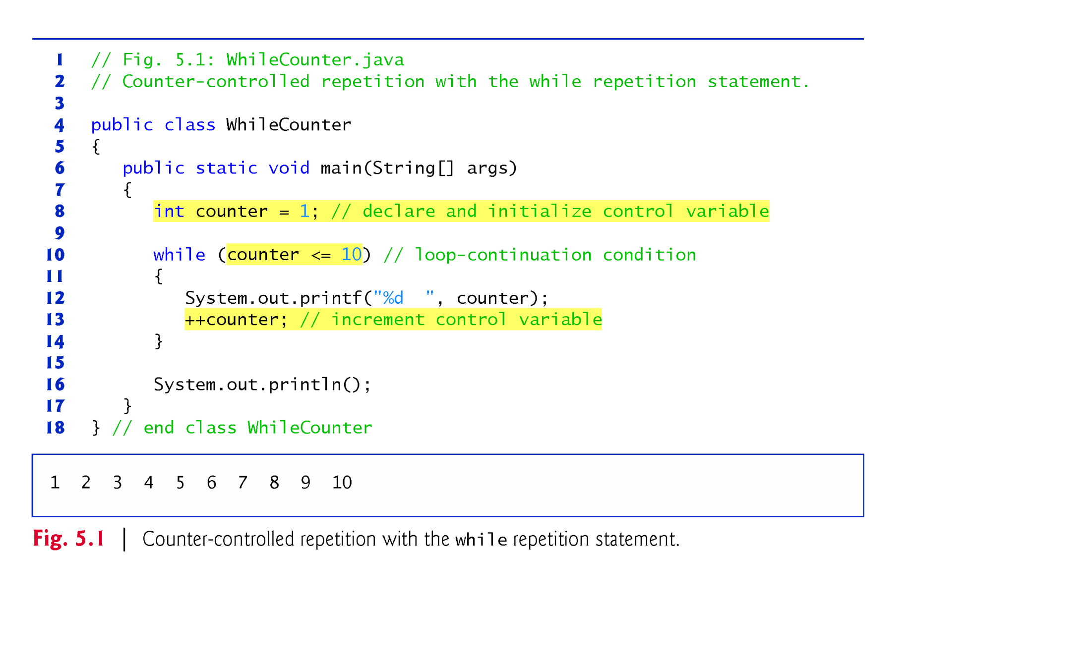
© Copyright 1992-2015 by Pearson Education, Inc. All Rights Reserved.

Slide 3
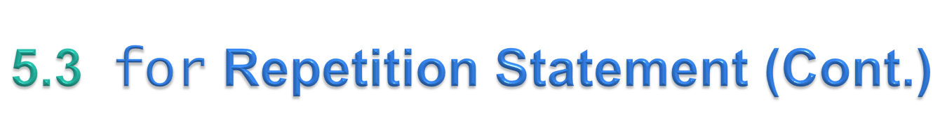
The general format of the for statement is
    for (initialization; loopContinuationCondition; increment)
    statement
  the initialization expression names the loop’s control variable and optionally provides its initial value
  loopContinuationCondition determines whether the loop should continue executing
  increment modifies the control variable’s value, so that the loop-continuation condition eventually becomes false.
The two semicolons in the for header are required.
© Copyright 1992-2015 by Pearson Education, Inc. All Rights Reserved.

Slide 4
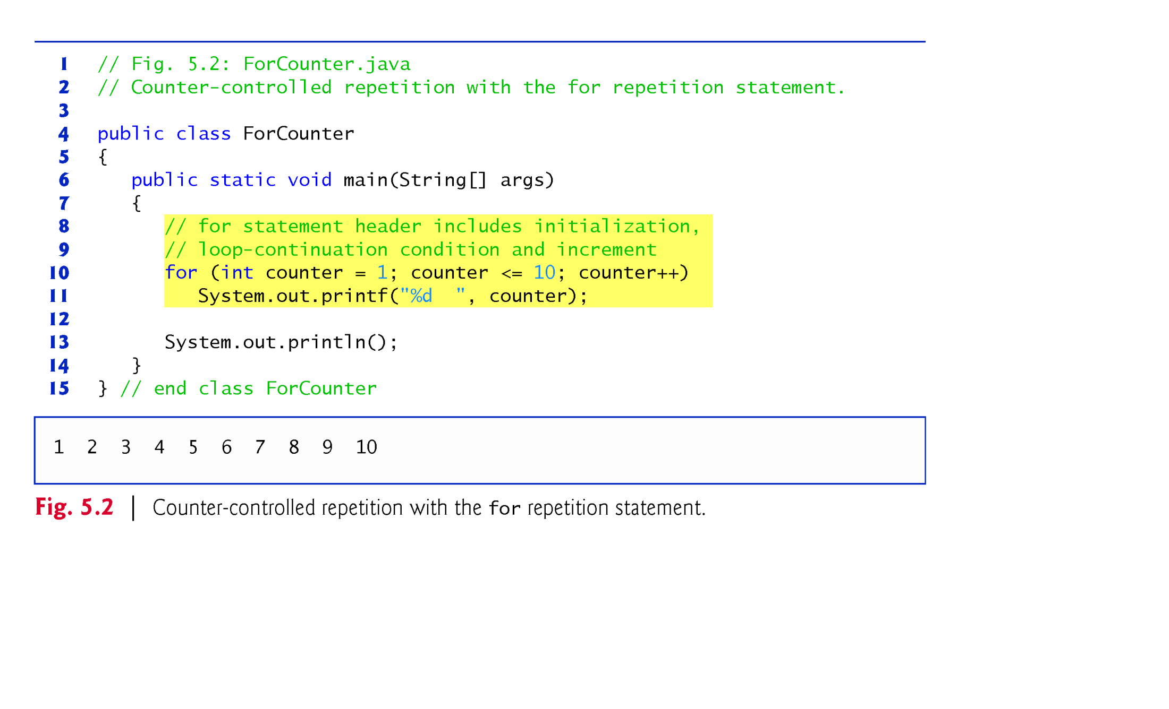
© Copyright 1992-2015 by Pearson Education, Inc. All Rights Reserved.

Slide 5
All three expressions in a for header are optional.
  If the loopContinuationCondition is omitted, the condition is always true, thus creating an infinite loop.
  You might omit the initialization expression if the program initializes the control variable before the loop.
  You might omit the increment if the program calculates it with statements in the loop’s body or if no increment is needed.
The increment expression in a for acts as if it were a standalone statement at the end of the for’s body, so
    counter = counter + 1
    counter += 1
    ++counter
    counter++
are equivalent increment expressions in a for statement.
© Copyright 1992-2015 by Pearson Education, Inc. All Rights Reserved.

Slide 6
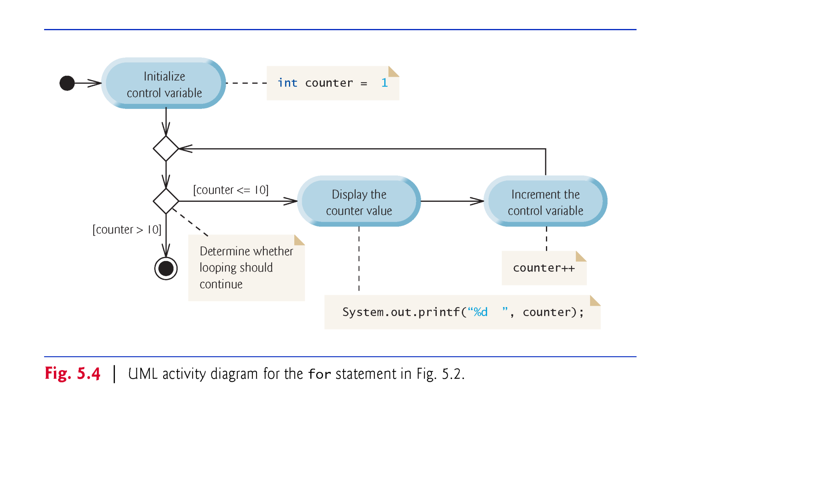
© Copyright 1992-2015 by Pearson Education, Inc. All Rights Reserved.

Slide 7
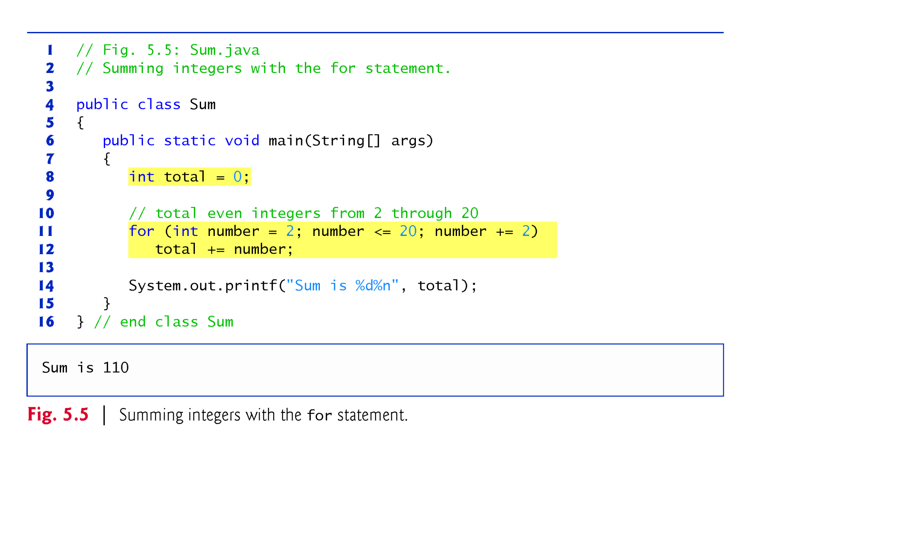
© Copyright 1992-2015 by Pearson Education, Inc. All Rights Reserved.

Slide 8
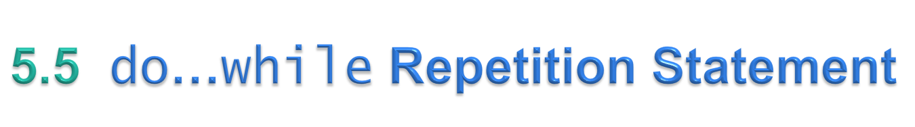
The do…while repetition statement is similar to the while statement.
In the while, the program tests the loop-continuation condition at the beginning of the loop, before executing the loop’s body; if the condition is false, the body never executes.
The do…while statement tests the loop-continuation condition after executing the loop’s body; therefore, the body always executes at least once.
When a do…while statement terminates, execution continues with the next statement in sequence.
© Copyright 1992-2015 by Pearson Education, Inc. All Rights Reserved.

Slide 9
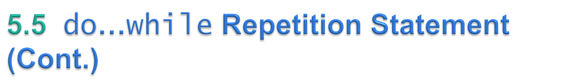
Braces are not required in the do…while repetition statement if there’s only one statement in the body.
Most programmers include the braces, to avoid confusion between the while and do…while statements.
Thus, the do…while statement with one body statement is usually written as follows:
    do
    {
    statement
    } while (condition);
© Copyright 1992-2015 by Pearson Education, Inc. All Rights Reserved.

Slide 10
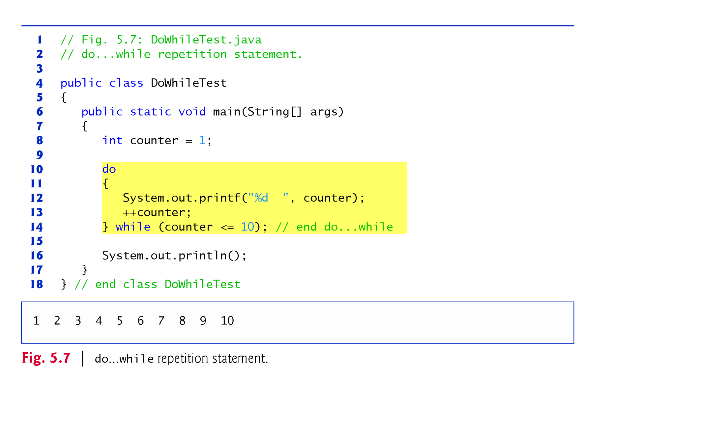
© Copyright 1992-2015 by Pearson Education, Inc. All Rights Reserved.

Slide 11
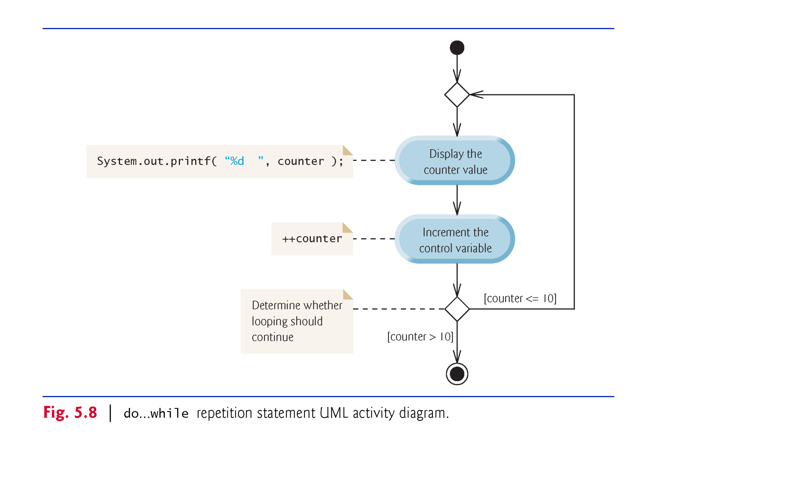
© Copyright 1992-2015 by Pearson Education, Inc. All Rights Reserved.

Slide 12
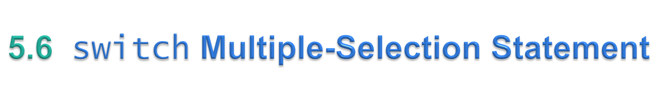
switch multiple-selection statement performs different actions based on the possible values of a constant integral expression of type byte, short, int or char.
© Copyright 1992-2015 by Pearson Education, Inc. All Rights Reserved.

Slide 13
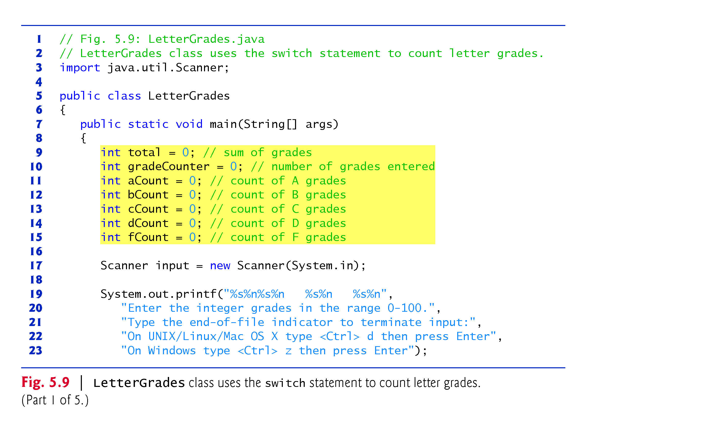
© Copyright 1992-2015 by Pearson Education, Inc. All Rights Reserved.

Slide 14
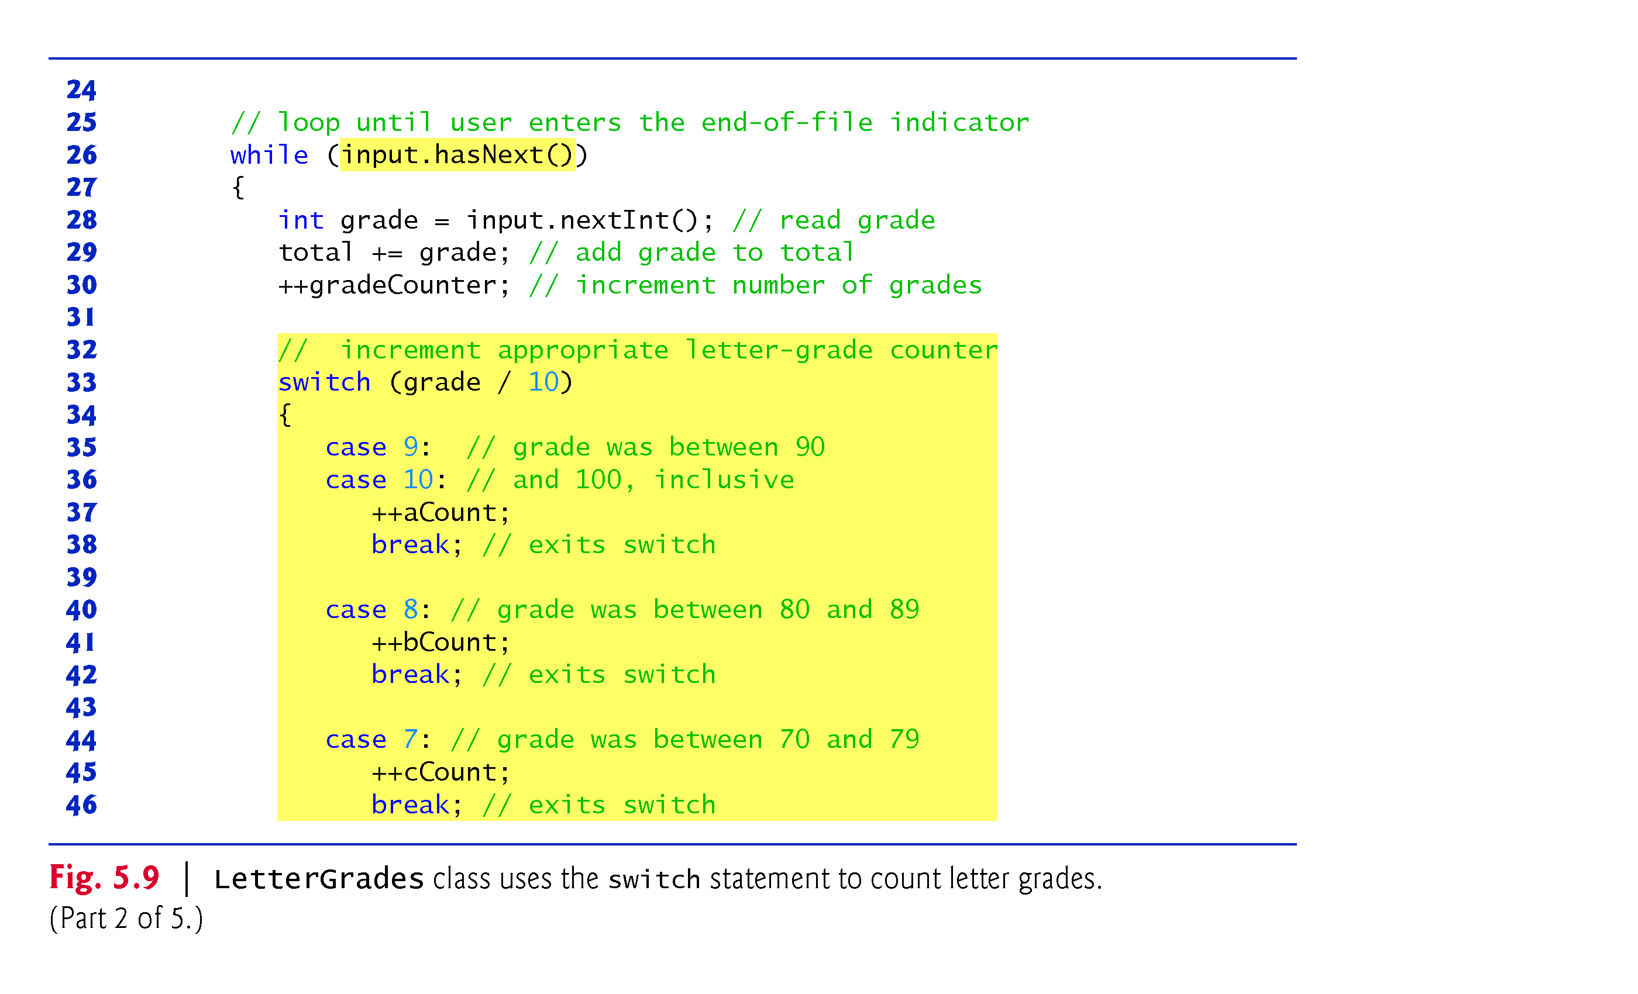
© Copyright 1992-2015 by Pearson Education, Inc. All Rights Reserved.

Slide 15
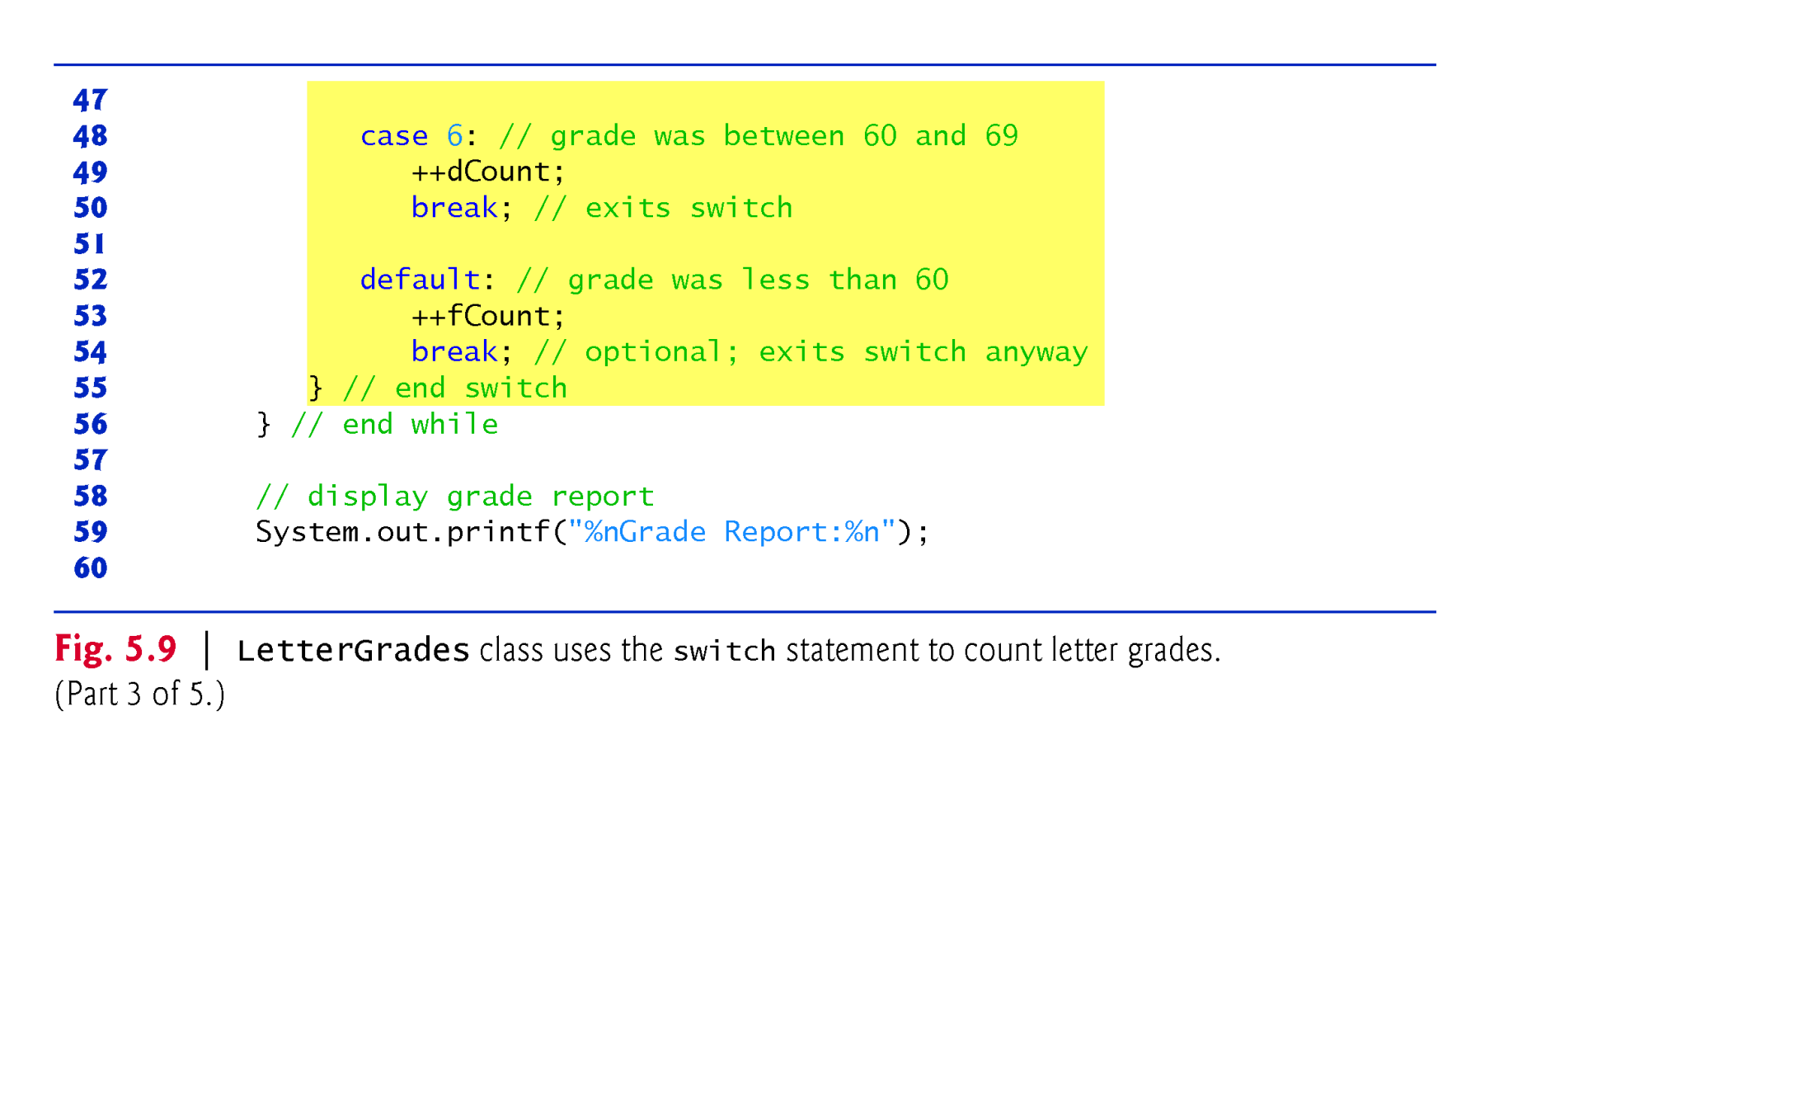
© Copyright 1992-2015 by Pearson Education, Inc. All Rights Reserved.

Slide 16
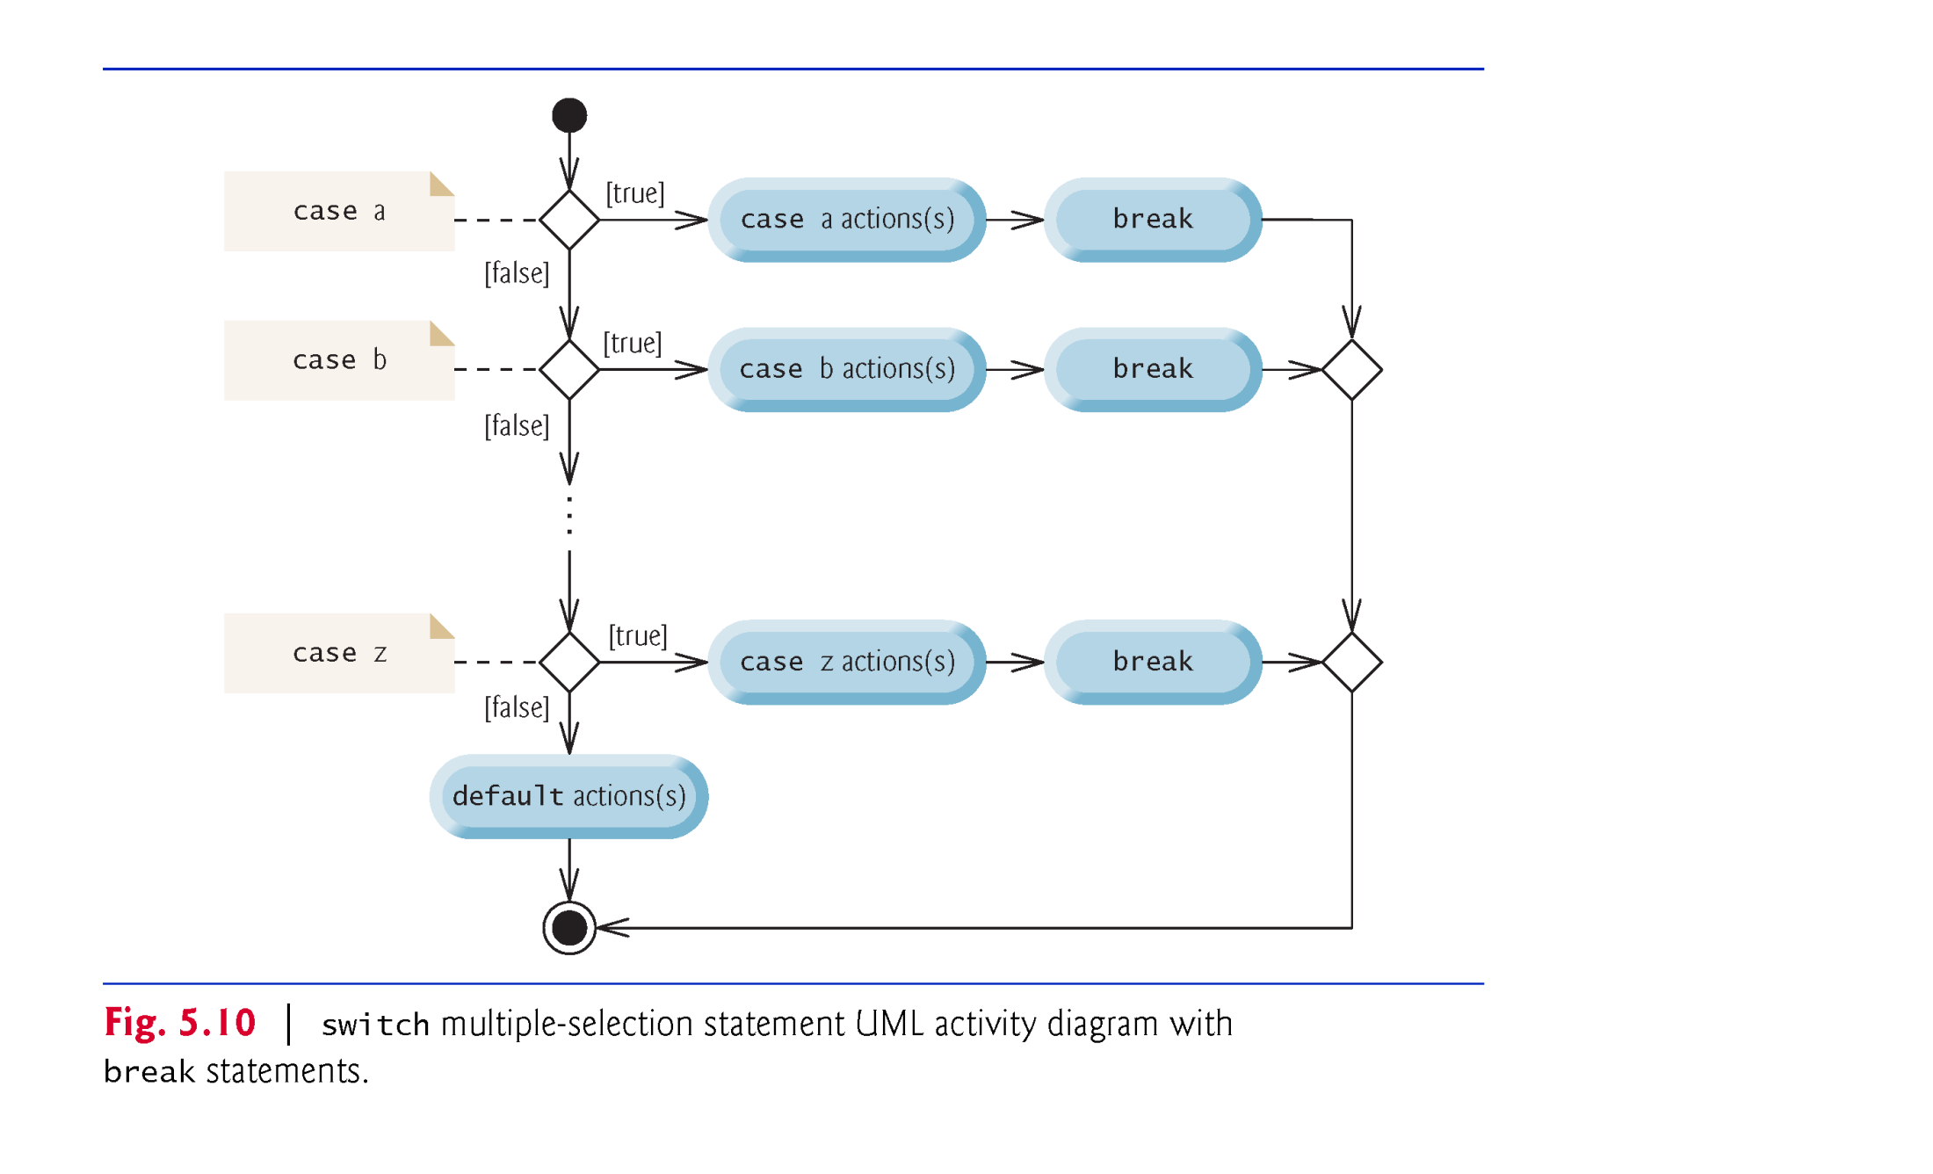
© Copyright 1992-2015 by Pearson Education, Inc. All Rights Reserved.

Slide 17

The break statement, when executed in a while, for, do…while or switch, causes immediate exit from that statement.
Execution continues with the first statement after the control statement.
Common uses of the break statement are to escape early from a loop or to skip the remainder of a switch.
© Copyright 1992-2015 by Pearson Education, Inc. All Rights Reserved.

Slide 18
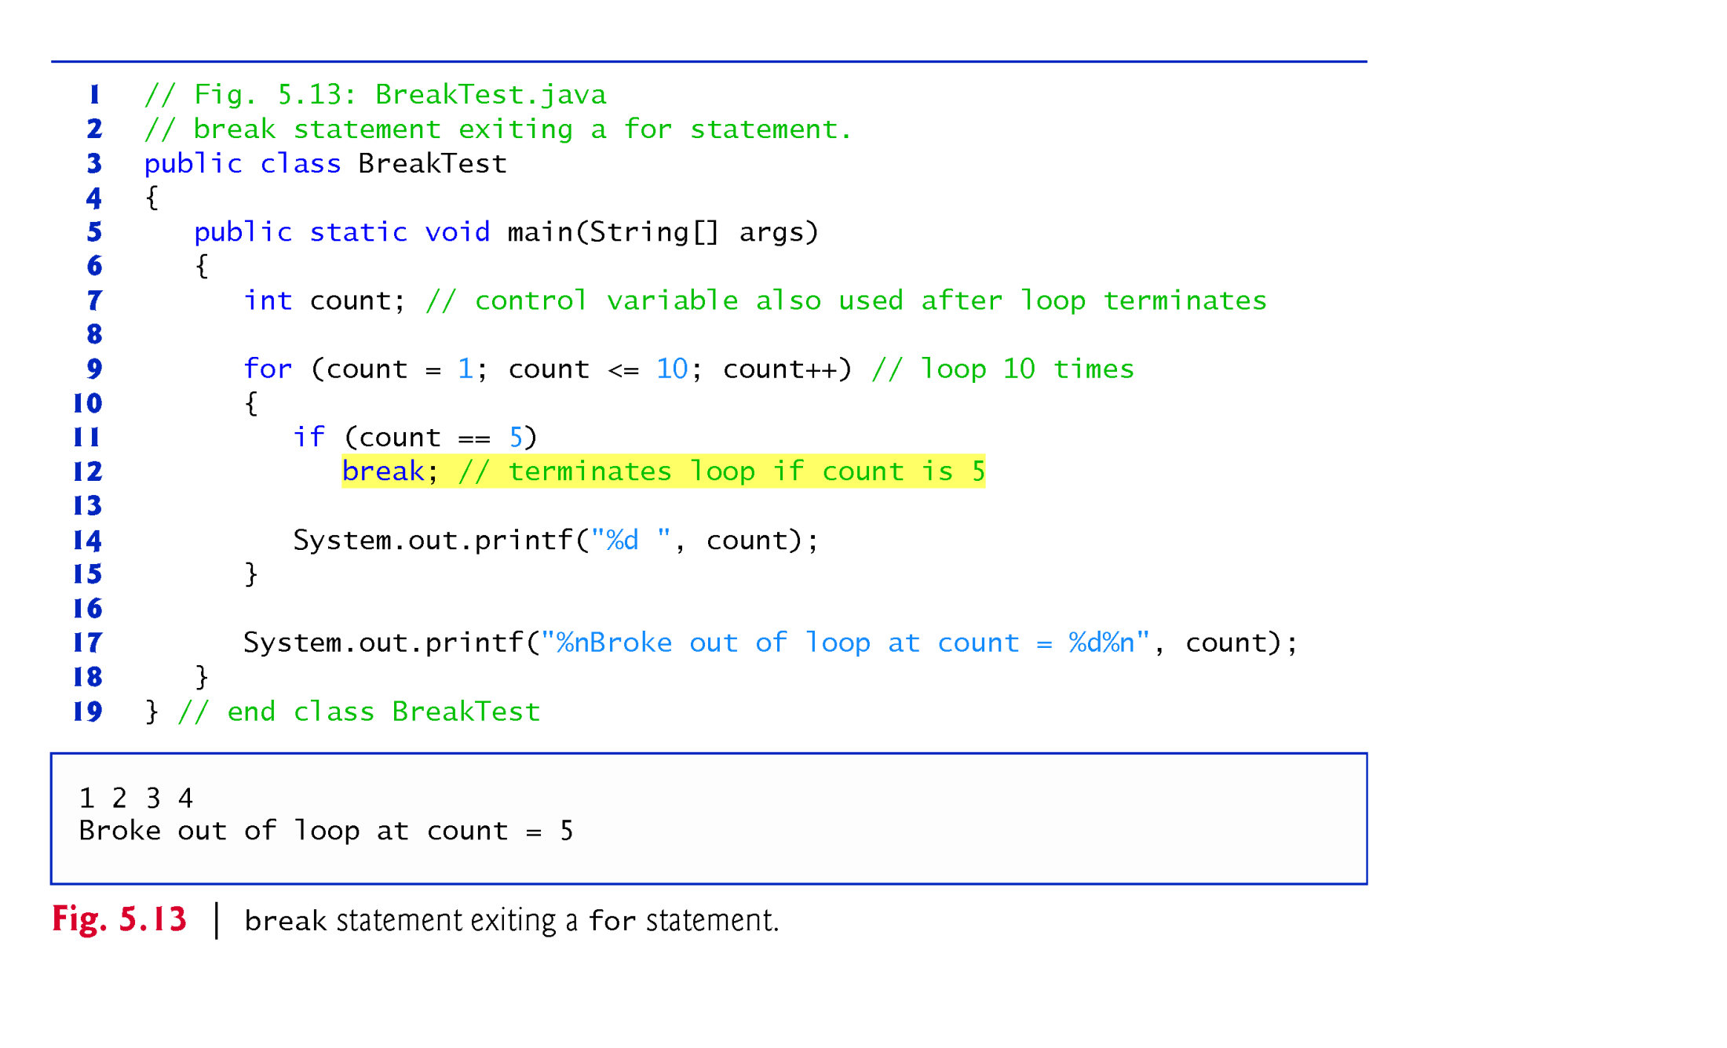
© Copyright 1992-2015 by Pearson Education, Inc. All Rights Reserved.

Slide 19

The continue statement, when executed in a while, for or do…while, skips the remaining statements in the loop body and proceeds with the next iteration of the loop.
In while and do…while statements, the program evaluates the loop-continuation test immediately after the continue statement executes.
In a for statement, the increment expression executes, then the program evaluates the loop-continuation test.
© Copyright 1992-2015 by Pearson Education, Inc. All Rights Reserved.

Slide 20
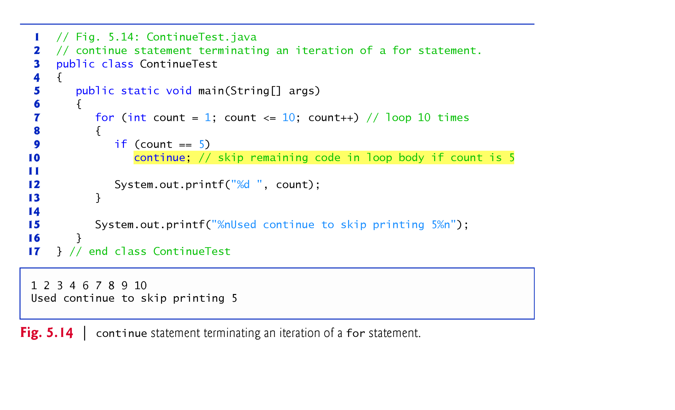
© Copyright 1992-2015 by Pearson Education, Inc. All Rights Reserved.

Slide 21

Java’s logical operators enable you to form more complex conditions by combining simple conditions.
The logical operators are
  && (conditional AND)
  || (conditional OR)
  & (boolean logical AND)
  | (boolean logical inclusive OR)
  ^ (boolean logical exclusive OR)
  ! (logical NOT).
[Note: The &, | and ^ operators are also bitwise operators when they are applied to integral operands.]
© Copyright 1992-2015 by Pearson Education, Inc. All Rights Reserved.

